Slide 1
An Introduction
to Scrum
<your name here>
<date>
Notes:
Two title slide choices are provided; use whichever you prefer

Slide 2
An Introduction to Scrum
Presented by
<you>
<date>

Slide 3

We’re losing the relay race
“The… ‘relay race’ approach to product development…may conflict with the goals of maximum speed and flexibility. Instead a holistic or ‘rugby’ approach—where a team tries to go the distance as a unit, passing the ball back and forth—may better serve today’s competitive requirements.”
Hirotaka Takeuchi and Ikujiro Nonaka, “The New New Product Development Game”, Harvard Business Review, January 1986.
Notes:
would be nice to include a quote from Wicked Problems here

Slide 4
Scrum in 100 words
Scrum is an agile process that allows us to focus on delivering the highest business value in the shortest time.
It allows us to rapidly and repeatedly inspect actual working software (every two weeks to one month).
The business sets the priorities. Teams self-organize to determine the best way to deliver the highest priority features.
Every two weeks to a month anyone can see real working software and decide to release it as is or continue to enhance it for another sprint.

Slide 5



Scrum origins

Slide 6
Scrum has been used by:
Microsoft
Yahoo
Google
Electronic Arts
IBM
Lockheed Martin
Philips
Siemens
Nokia
Capital One
BBC
Intuit
Nielsen Media
First American Real Estate
BMC Software
Ipswitch
John Deere
Lexis Nexis
Sabre
Salesforce.com
Time Warner
Turner Broadcasting
Oce

Slide 7
Scrum has been used for:
Commercial software
In-house development
Contract development
Fixed-price projects
Financial applications
ISO 9001-certified applications
Embedded systems
24x7 systems with 99.999% uptime requirements
the Joint Strike Fighter
Video game development
FDA-approved, life-critical systems
Satellite-control software
Websites
Handheld software
Mobile phones
Network switching applications
ISV applications
Some of the largest applications in use

Slide 8
Characteristics
Self-organizing teams
Product progresses in a series of 1-4 week “sprints”
Requirements are captured as items in a list of “product backlog”
No specific engineering practices prescribed
Uses generative rules to create an agile environment for delivering projects
One of the “agile processes”

Slide 9

The Agile Manifesto–a statement of values
Individuals and interactions
over
Process and tools
Comprehensive documentation
Working software
over
Customer collaboration
over
Contract negotiation
Responding to change
over
Following a plan
Source: www.agilemanifesto.org

Slide 10

Project noise level
Far from
Agreement
Anarchy
Complex
Requirements
Complicated
Source: Strategic Management and Organizational Dynamics by Ralph Stacey in Agile Software Development with Scrum by Ken Schwaber and Mike Beedle.
Close to
Agreement
Simple
Technology
Close to
Certainty
Far from
Certainty

Slide 11





Scrum
24 hours
Sprint
2-4 weeks
Sprint goal
Return
Sprint backlog
Return
Cancel
Potentially shippable
product increment
Gift wrap
Coupons
Gift wrap
Cancel
Coupons
Product
backlog

Slide 12
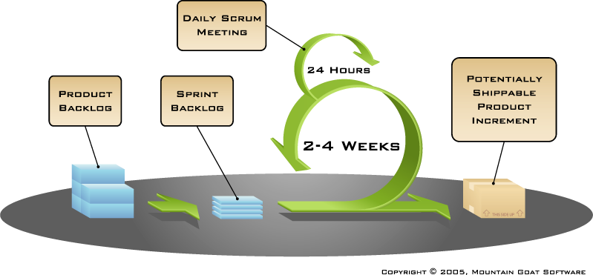
Putting it all together
Image available at www.mountaingoatsoftware.com/scrum

Slide 13
Sprints
Scrum projects make progress in a series of “sprints”
Analogous to Extreme Programming iterations
Typical duration is 2–4 weeks or a calendar month at most
A constant duration leads to a better rhythm
Product is designed, coded, and tested during the sprint

Slide 14

Sequential vs. overlapping development
Requirements
Design
Code
Test
Rather than doing all of one thing at a time...
...Scrum teams do a little of everything all the time
Source: “The New New Product Development Game” by Takeuchi and Nonaka. Harvard Business Review, January 1986.

Slide 15


No changes during a sprint
Change
Plan sprint durations around how long you can commit to keeping change out of the sprint

Slide 16
Scrum framework
Roles
Product owner
ScrumMaster
Team
Ceremonies
Sprint planning
Sprint review
Sprint retrospective
Daily scrum meeting
Artifacts
Product backlog
Sprint backlog
Burndown charts

Slide 17
Scrum framework
Roles
Product owner
ScrumMaster
Team
Ceremonies
Sprint planning
Sprint review
Sprint retrospective
Daily scrum meeting
Artifacts
Product backlog
Sprint backlog
Burndown charts

Slide 18

Product owner
Define the features of the product
Decide on release date and content
Be responsible for the profitability of the product (ROI)
Prioritize features according to market value
Adjust features and priority every iteration, as needed
Accept or reject work results

Slide 19

The ScrumMaster
Represents management to the project
Responsible for enacting Scrum values and practices
Removes impediments
Ensure that the team is fully functional and productive
Enable close cooperation across all roles and functions
Shield the team from external interferences

Slide 20





The team
Typically 5-9 people
Cross-functional:
Programmers, testers, user experience designers, etc.
Members should be full-time
May be exceptions (e.g., database administrator)
Teams are self-organizing
Ideally, no titles but rarely a possibility
Membership should change only between sprints

Slide 21
Scrum framework
Roles
Product owner
ScrumMaster
Team
Ceremonies
Sprint planning
Sprint review
Sprint retrospective
Daily scrum meeting
Artifacts
Product backlog
Sprint backlog
Burndown charts

Slide 22


Sprint planning meeting
Team capacity
Sprint prioritization
Analyze and evaluate product backlog
Select sprint goal
Sprint
goal
Product backlog
Business conditions
Sprint planning
Decide how to achieve sprint goal (design)
Create sprint backlog (tasks) from product backlog items (user stories / features)
Estimate sprint backlog in hours
Current product
Sprint
backlog
Technology

Slide 23

Sprint planning
Team selects items from the product backlog they can commit to completing
Sprint backlog is created
Tasks are identified and each is estimated (1-16 hours)
Collaboratively, not done alone by the ScrumMaster
High-level design is considered
As a vacation planner, I want to see photos of the hotels.
Code the middle tier (8 hours)
Code the user interface (4)
Write test fixtures (4)
Code the foo class (6)
Update performance tests (4)

Slide 24
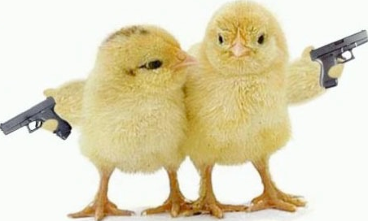
The daily scrum
Parameters
Daily
15-minutes
Stand-up
Not for problem solving
Whole world is invited
Only team members, ScrumMaster, product owner, can talk
Helps avoid other unnecessary meetings

Slide 25

Everyone answers 3 questions
1
What did you do yesterday?
2
What will you do today?
3
Is anything in your way?
These are not status for the ScrumMaster
They are commitments in front of peers

Slide 26
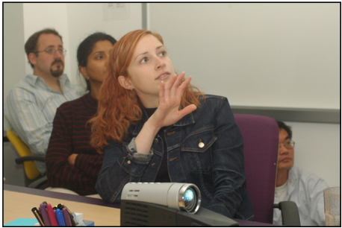
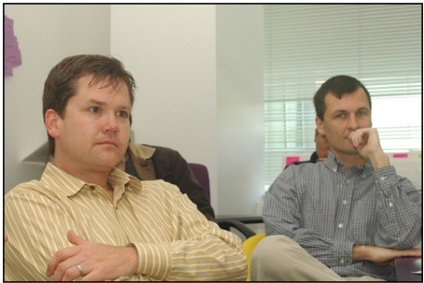
The sprint review
Team presents what it accomplished during the sprint
Typically takes the form of a demo of new features or underlying architecture
Informal
2-hour prep time rule
No slides
Whole team participates
Invite the world

Slide 27
Sprint retrospective
Periodically take a look at what is and is not working
Typically 15–30 minutes
Done after every sprint
Whole team participates
ScrumMaster
Product owner
Team
Possibly customers and others

Slide 28

Start / Stop / Continue
Whole team gathers and discusses what they’d like to:
Start doing
Stop doing
This is just one of many ways to do a sprint retrospective.
Continue doing

Slide 29
Scrum framework
Roles
Product owner
ScrumMaster
Team
Ceremonies
Sprint planning
Sprint review
Sprint retrospective
Daily scrum meeting
Artifacts
Product backlog
Sprint backlog
Burndown charts

Slide 30

Product backlog
The requirements
A list of all desired work on the project
Ideally expressed such that each item has value to the users or customers of the product
Prioritized by the product owner
Reprioritized at the start of each sprint
This is the product backlog

Slide 31
A sample product backlog
Backlog item | Estimate
Allow a guest to make a reservation | 3
As a guest, I want to cancel a reservation. | 5
As a guest, I want to change the dates of a reservation. | 3
As a hotel employee, I can run RevPAR reports (revenue-per-available-room) | 8
Improve exception handling | 8
... | 30
... | 50

Slide 32
The sprint goal
A short statement of what the work will be focused on during the sprint
Life Sciences
Support features necessary for population genetics studies.
Database Application
Make the application run on SQL Server in addition to Oracle.
Financial services
Support more technical indicators than company ABC with real-time, streaming data.

Slide 33
Managing the sprint backlog
Individuals sign up for work of their own choosing
Work is never assigned
Estimated work remaining is updated daily
Any team member can add, delete or change the sprint backlog
Work for the sprint emerges
If work is unclear, define a sprint backlog item with a larger amount of time and break it down later
Update work remaining as more becomes known

Slide 34
A sprint backlog
Tasks
Mon
Tues
Wed
Thur
Fri
Code the user interface
8
4
8
Code the middle tier
16
12
10
4
Test the middle tier
8
16
16
11
8
Write online help
12
Write the foo class
8
8
8
8
8
Add error logging
8
4

Slide 35
A sprint burndown chart
Hours

Slide 36
Tasks
Mon
Tues
Wed
Thur
Fri
Code the user interface
8
4
8
Code the middle tier
16
12
10
7
Test the middle tier
8
16
16
11
8
Write online help
12
50
40
30
Hours
20
10
0
Mon
Tue
Wed
Thu
Fri

Slide 37
Scalability
Typical individual team is 7 ± 2 people
Scalability comes from teams of teams
Factors in scaling
Type of application
Team size
Team dispersion
Project duration
Scrum has been used on multiple 500+ person projects

Slide 38






Scaling through the Scrum of scrums

Slide 39
Scrum of scrums of scrums

Slide 40
Where to go next
www.mountaingoatsoftware.com/scrum
www.ScrumFoundations.com
www.mountaingoatsoftware.com/agile
scrumdevelopment@yahoogroups.com

Slide 41
A Scrum reading list
Agile Estimating and Planning by Mike Cohn
Agile Product Management: Creating Products that Customers Love by Roman Pichler
Agile Project Management with Scrum by Ken Schwaber
Agile Software Development Ecosystems by Jim Highsmith
Essential Scrum: A Practical Guide to the Most Popular Agile Process by Kenneth Rubin
Scrum and XP from the Trenches by Henrik Kniberg
Succeeding with Agile: Software Development using Scrum by Mike Cohn
The Scrum Guide at www.ScrumGuides.org
User Stories Applied for Agile Software Development by Mike Cohn

Slide 42
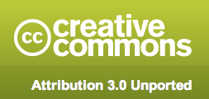
Copyright notice
You are free:
to Share―to copy, distribute and and transmit the work
to Remix―to adapt the work
Under the following conditions
Attribution. You must attribute the work in the manner specified by the author or licensor (but not in any way that suggests that they endorse you or your use of the work).
Nothing in this license impairs or restricts the author’s moral rights.
For more information see http://creativecommons.org/licenses/by/3.0/

Slide 43


Contact information
Presentation by: Mike Cohn
mike@mountaingoatsoftware.com
www.mountaingoatsoftware.com
(720) 890-6110
You can remove this (or any slides) but please credit the source somewhere in your presentation

